Slide 1

128-bit AES (Advanced Encryption Standard) (Decryption)
Aditya Gupta (20116003)
Akash Jha (20116005)
Apoorva Verma (20115018)
Apurba Prasad Padhy (20310005)
Tushar Sahu (20116102)

Slide 2
Outline
Problem Statement
Block Diagram
Flow Chart
Algorithms/Steps
RTL Verilog Code
Schematic of Sub-blocks
Simulation Result 1
Simulation Result 2
Simulation Result 3
Summary

Slide 3
Problem Statement
Maintaining confidentiality and ensuring security of sensitive data is an open problem in today’s age of information technology.
It is also necessary to make sure that the transmitted data is not modified, intentionally or unintentionally, and that the authenticity of the sender is verified correctly.
In this context, various cryptographic specifications have been developed to protect data from being accessed by anyone other than the sender and the intended receiver.
The AES (Advanced Encryption Standard) is a block-cipher algorithm known for its considerable improvements over its predecessors especially with respect to portability and security.
In this project, we aim to implement 128-bit AES algorithm on an FPGA board using Verilog hardware coding (only decryption).

Slide 4
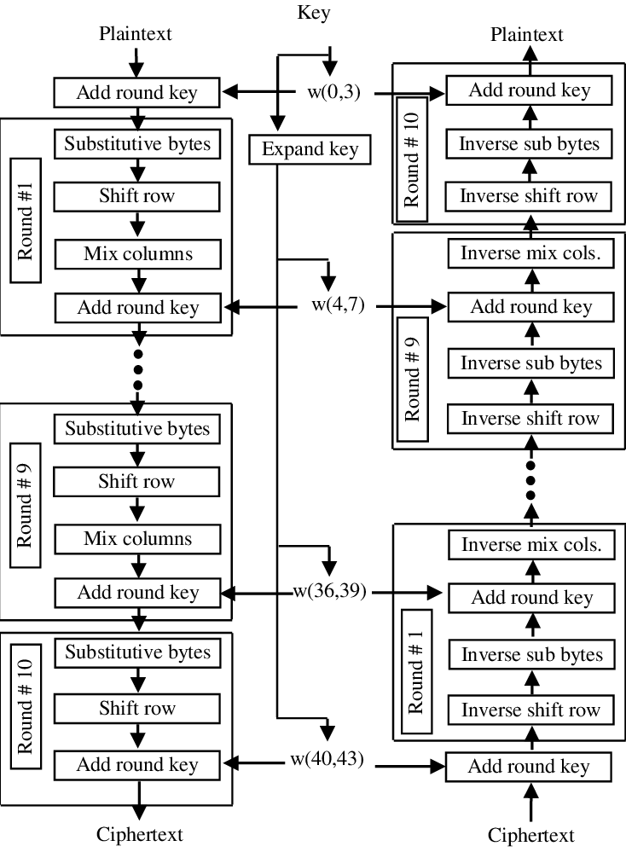
Block Diagram
Encryption
Decryption

Slide 5
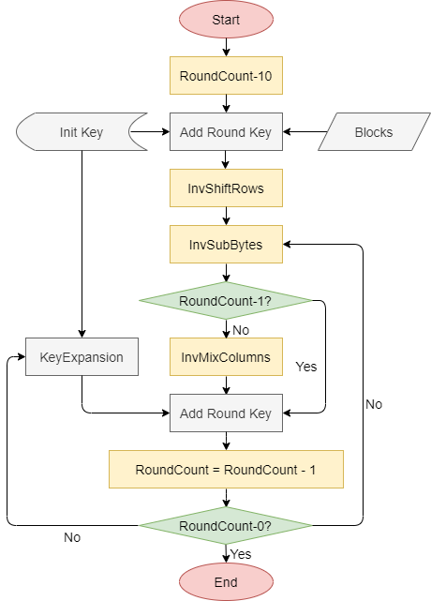
Flow Chart for Decryption

Slide 6
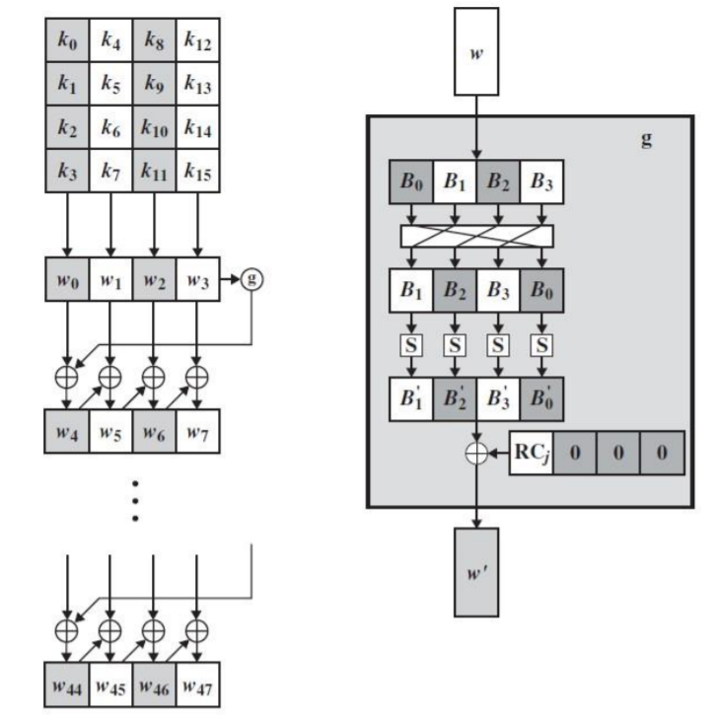
Step 1: Key Expansion
Before beginning the decryption process, the key is passed through a key expansion function, which produces 11 round keys, which are used as one of the inputs at every ‘Add Round Key’ stage.
In the key expansion process, the previous key is used to obtain next key, to get the next key from the previous one, the last column of the previous key is passed as argument to some function, let us call this function 'g'.
The function g involves following steps:
This function accepts 1 word (4 bytes) perform left shift operation and a substitute byte transformation.
The matrix is then bitwise XORed with the round constant.
The matrix thus obtained is the output of the function.
The output of the function is then XORed with the first column (first word) of the previous key to get the first column (first word) of the next key. The obtained word is then XORed with the second column of the previous key to get the second column, and so on. Thus, we get the next key.

Slide 7
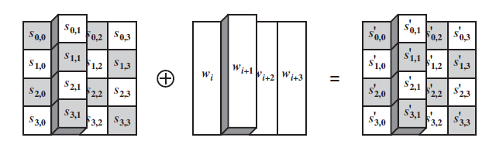
Step 2: Pre-Round Transformation
In this round, we bitwise XOR the original data (128 bits) i.e., 4 words with the last key of 128 bits generated during the key expansion process.
The output of this round is input for round 1.

Slide 8
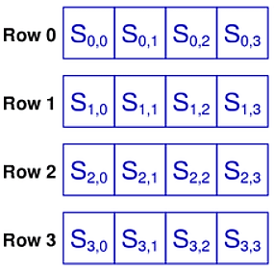

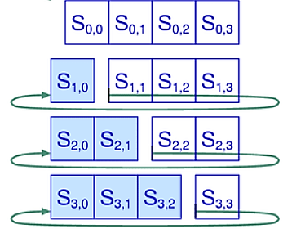
Step 3: Inverse Shift Row
The inverse shift row transformation performs circular shifts in such a way that the i^{th} row undergoes (i-1) 1-byte right shifts.
The rationale behind the Shift Rows operation was to spread out 4 bytes of one column to different columns and introduce a degree of randomness in the cipher.

Slide 9
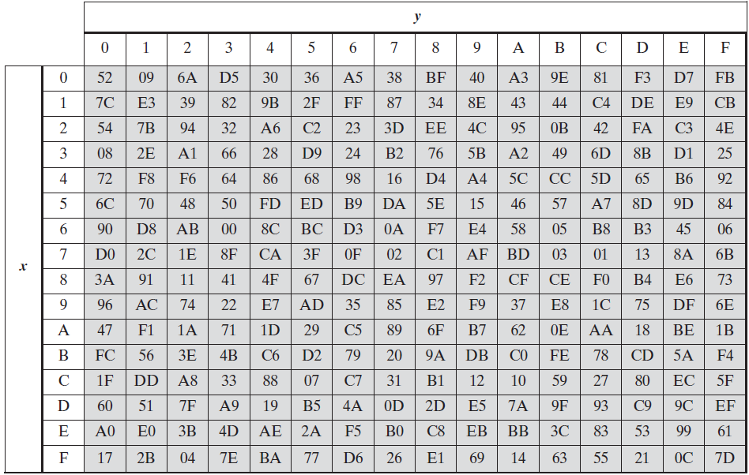
Step 4: Inverse Sub Bytes
This transformation uses the Inverse S-Box to find one-to-one replacement bytes for all possible bytes in the input state array. The table is derived from the inverse function over GF(2⁸).

Slide 10
Step 5: Add Round Key
In the AddRoundKey transformation, the key is bitwise XORed with the state matrix.
In AES decryption process, the last key (of the expanded keys) is used in the preround transformation. The second last key is used in the first round and so on.
Finally, the initial key is used in the last round. This is done to exactly reverse the encryption process.

Slide 11
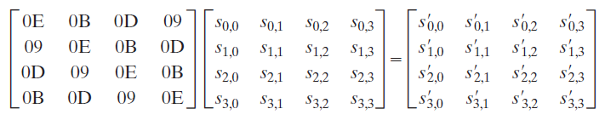
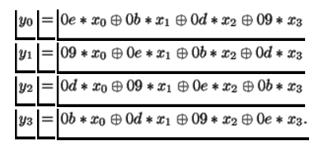
Step 6: Inverse Mix Columns
The state matrix is represented as column polynomials over GF(2⁸) and the transformation consists of matrix multiplication of the state with a polynomial over a finite field.
This works after the AddRoundKey stage to ensure that all parts of the block affect each other. For a data block of 128 bits, the state matrix has 4 rows. Therefore, the columns of the state matrix are each viewed as the polynomial of degree 8 over GF(2⁸) and multiplied modulo (x⁴ +1).

Slide 12
Step 7: Final Round
The aforementioned steps are now repeated 8 times.
In the final round (10th round), we skip the ‘InvMixColumns’ operation (that is, we only perform InvShiftRows, InvSubBytes, AddRoundKey).
At the end of these 10 rounds, we obtain the plaintext from the ciphertext.

Slide 13
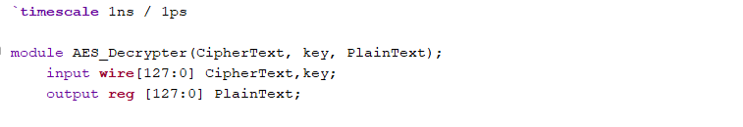
RTL Verilog Code

Slide 14
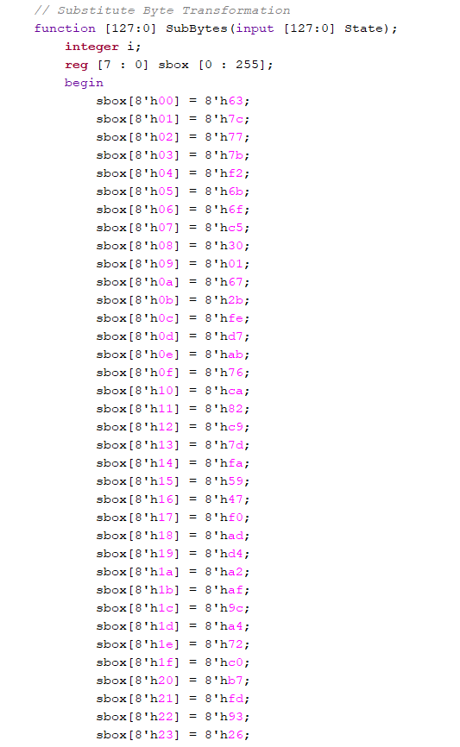
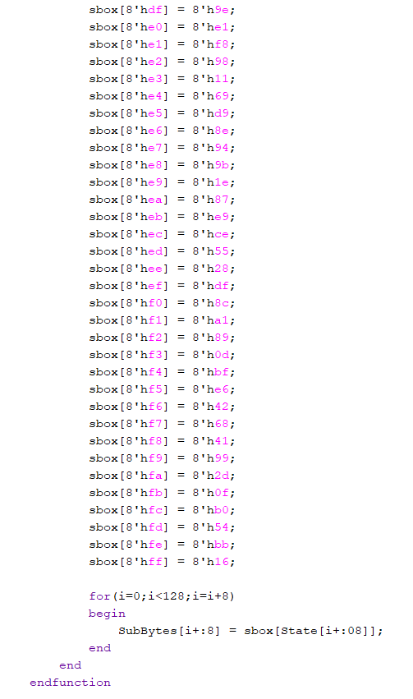
RTL Verilog Code (S-Box)

Slide 15
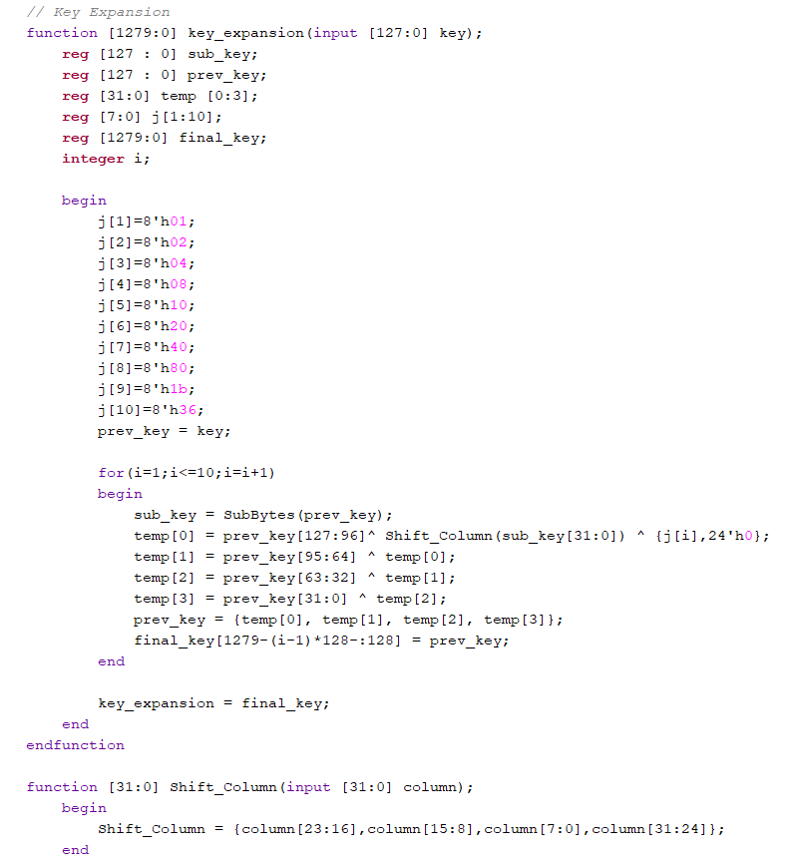
RTL Verilog Code (Key Expansion)

Slide 16
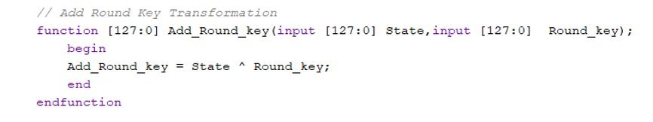
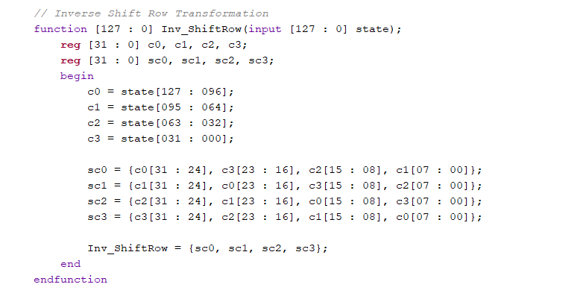
RTL Verilog Code (Add Round Key & Inverse Shift Rows)
127-120 | 95-88 | 63-56 | 31-24
119-112 | 87-80 | 55-48 | 23-16
111-104 | 79-72 | 47-40 | 15-08
103-96 | 71-64 | 39-32 | 07-00
127-120 | 95-88 | 63-56 | 31-24
23-16 | 119-112 | 87-80 | 55-48
47-40 | 15-08 | 111-104 | 79-72
71-64 | 39-32 | 07-00 | 103-96

Slide 17
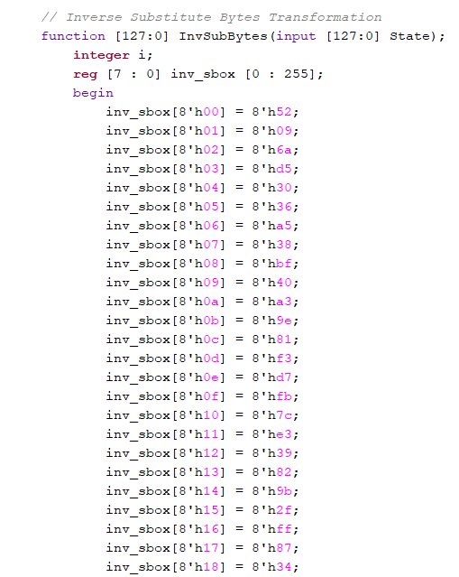
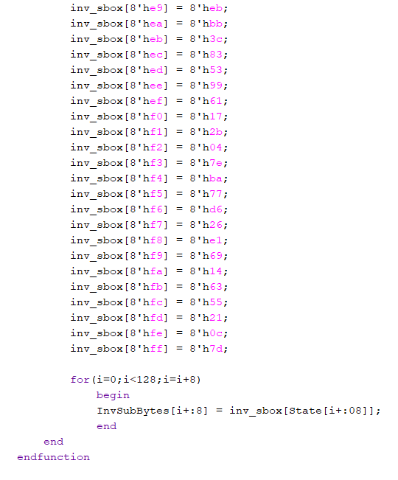
RTL Verilog Code (Inverse S-box)

Slide 18
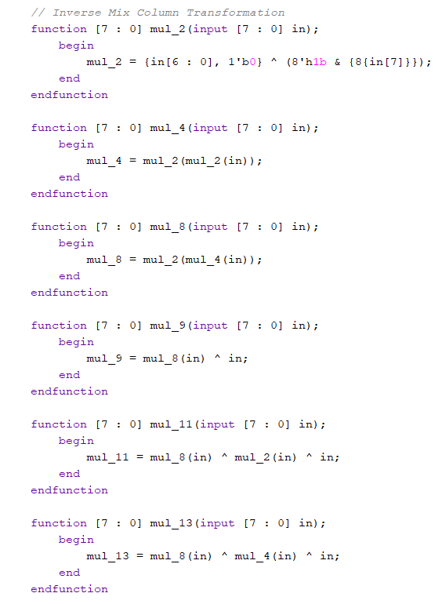
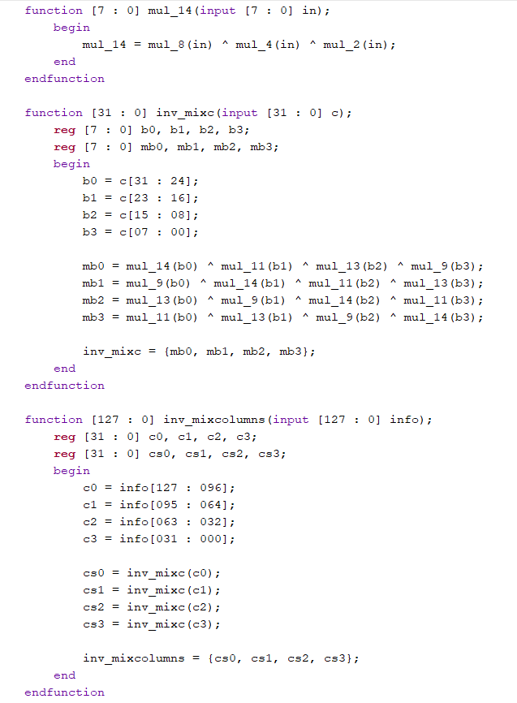
RTL Verilog Code (Inverse Mix Column)

Slide 19
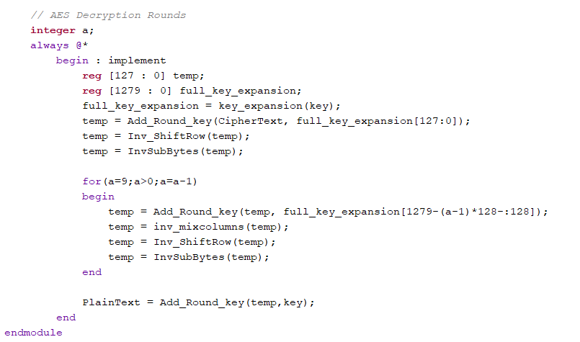
RTL Verilog Code (AES Decryption Rounds)

Slide 20
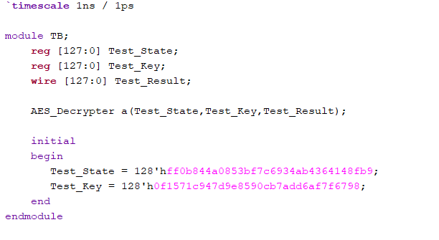
RTL Verilog Code (Test Bench)

Slide 21
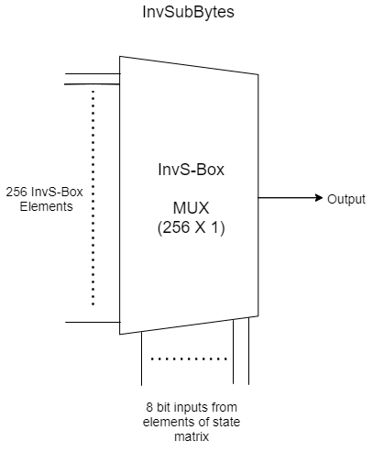
Schematic of InvSubBytes

Slide 22
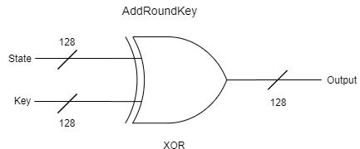
Schematic of AddRoundKey

Slide 23
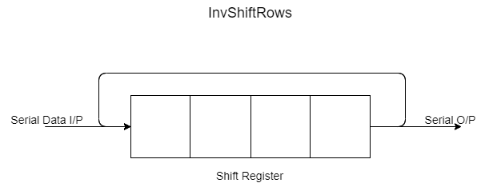

Schematic of InvShiftRows

Slide 24
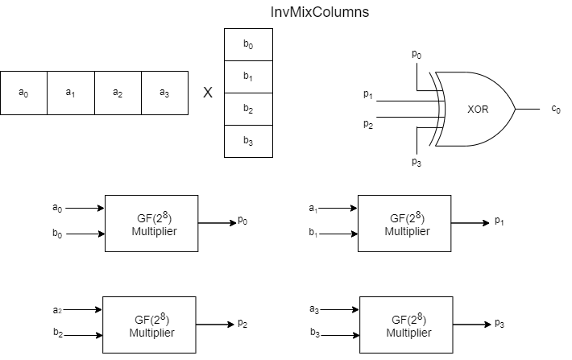
Schematic of InvMixColumns

Slide 25
Simulation Results
S.No. | Ciphertext | Key | Expected Plaintext
1 | 29c3505F571420f6402299b31a02d73a | 5468617473206d79204b756e67204675 | 54776f204f665204e696e652054776f
2 | ff0b844a0853bf7c6934ab4364148fb9 | 0f1571c947d9e8590cb7add6af7f6798 | 0123456789abcedffedcba9876543210
3 | ae7614a563d5f29824182476369ffff | f1571c9546ae74863ef9752467983344 | 63881d081750d77786fc1c42c0717c93
We have used Xilinx Vivado v2020.2 (64-bit) for running our simulations.
The ciphertext-key-plaintext triplets required for validation have been generated using an online tool that can be found here.

Slide 26
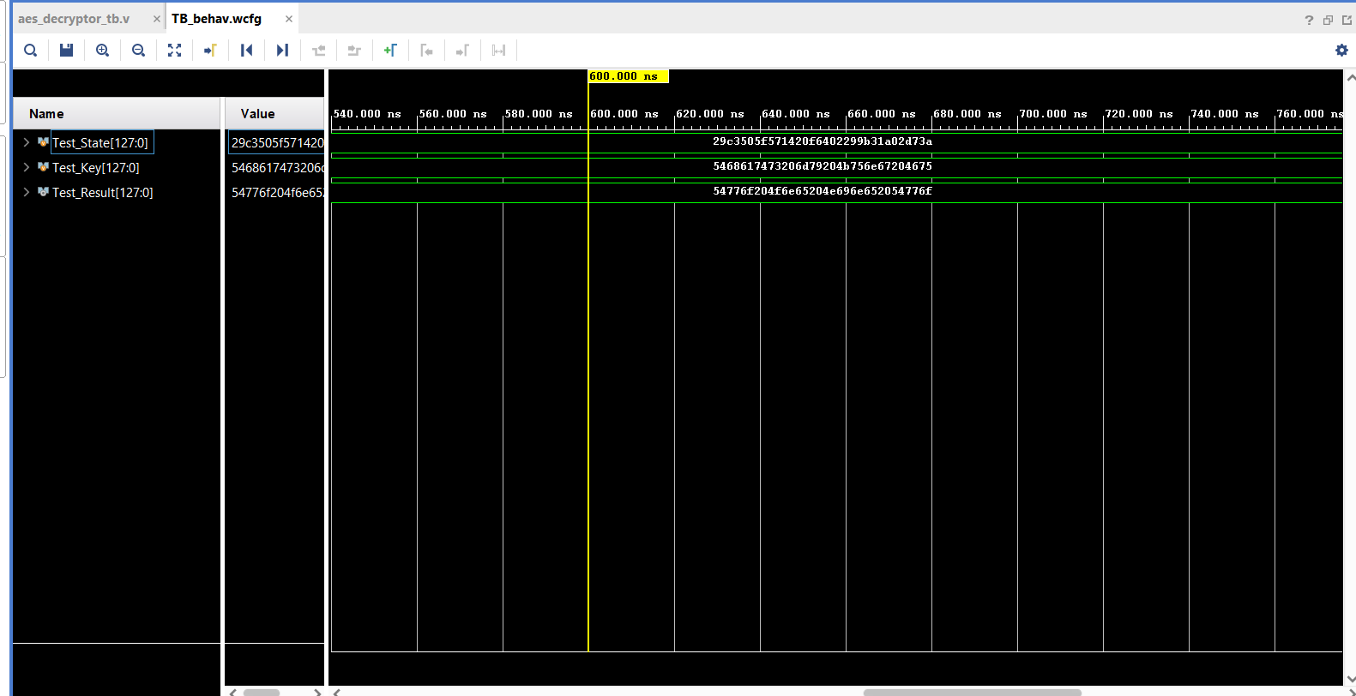
Simulation Result 1

Slide 27
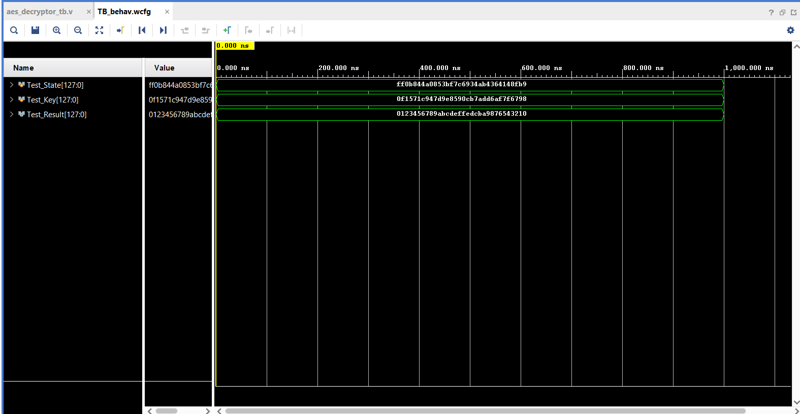
Simulation Result 2

Slide 28
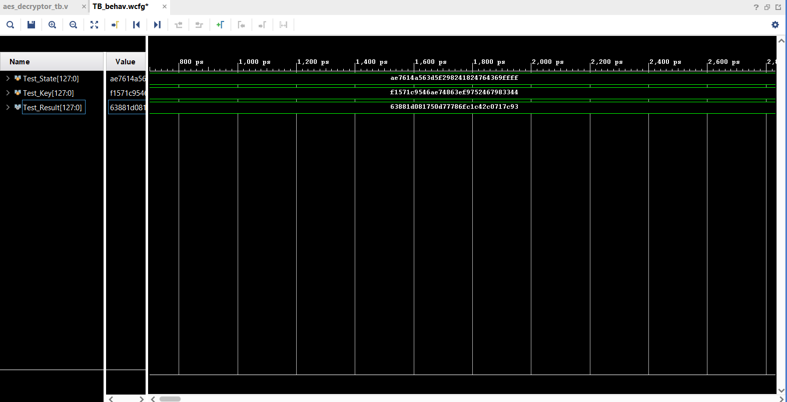
Simulation Result 3

Slide 29
Summary
The Advanced Encryption Standard (AES) algorithm makes vast improvements over its predecessors in both security and speed.
In this project, we have seen how this algorithm can be implemented on hardware (using Verilog).
The four stages involved in encryption are entirely reversible with the help of the key. Thus, we can obtain the desired plaintext from ciphertext easily.
With no apparent mathematical weakness discovered yet, we can be reasonably confident that AES will keep our data secure for the years to come.

